Slide 1
Computer Vision with OpenCV
PIRL, POSTECH

Slide 2
OpenCV Basic
Image Processing
Image Filtering
Deep Learning in OpenCV

Slide 3


OpenCV Basic
Introduction
OpenCV is an Image Processing library created by Intel and maintained by Willow Garage.
Available for C, C++, and Python
Newest update is version 4.1.1
Open Source and free
Easy to use and install

Slide 4
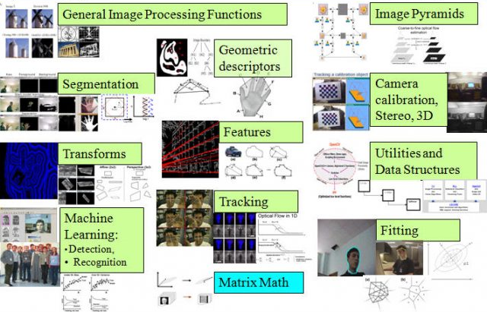
OpenCV Basic
Introduction

Slide 5
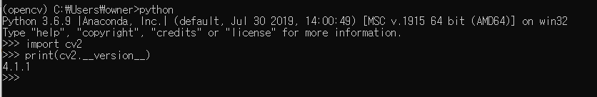
OpenCV Basic
Installation
Conda activate <your environment>
Conda install –c conda-forge opencv
Check installation on terminal or IDE

Slide 6
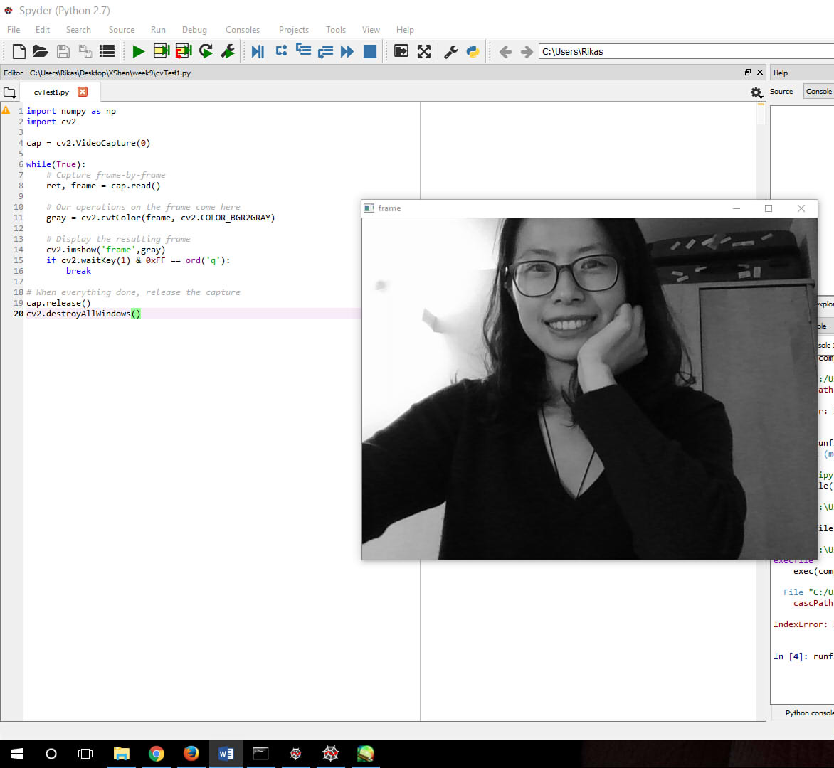
Getting Started with Images
Read Image – cv2.imread()
Display Image – cv2.imshow()

Slide 7
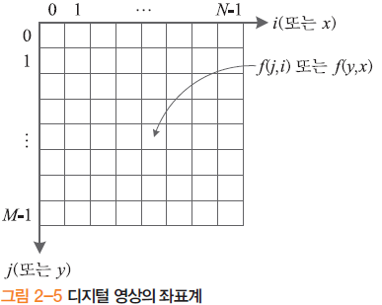
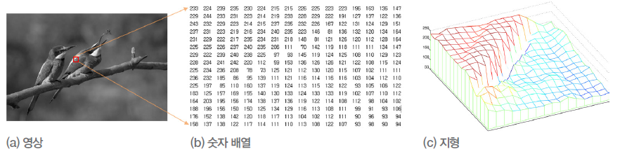
Getting Started with Images
영상 좌표계
화소 위치는 x=(j,i) 또는 x=(y,x)로 표기
영상은 f(x) 또는 f(j,i), 0≤j≤M-1, 0≤j≤N-1로 표기
컬러 영상은 fr(x), fg(x), fb(x)의 세 채널로 구성

Slide 8
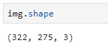
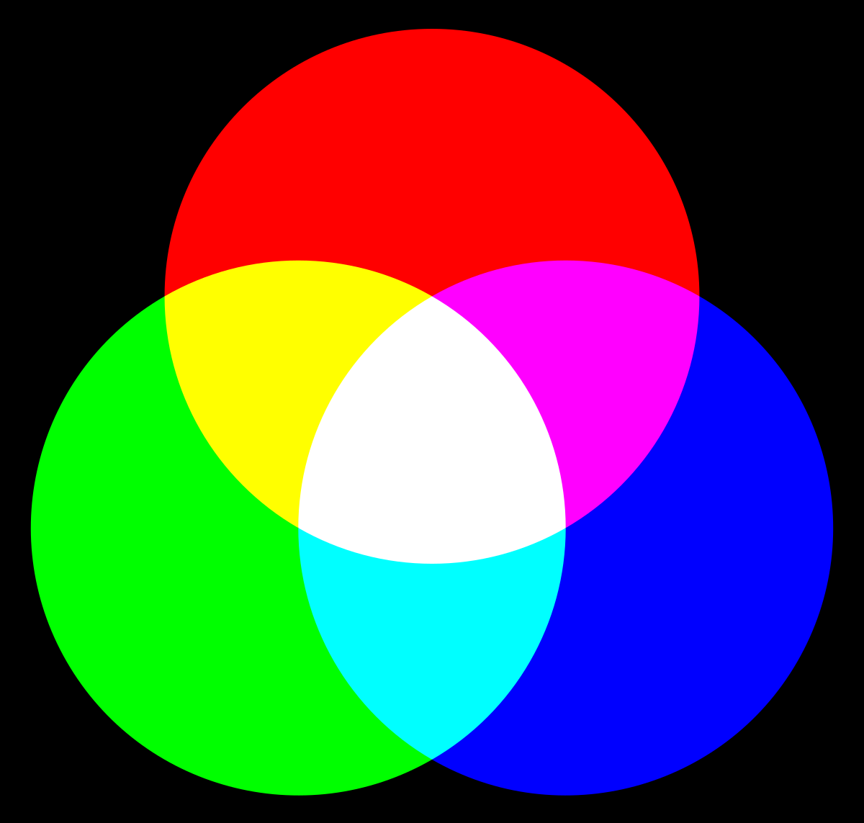

Getting Started with Images
3(RGB)
(255, 0, 0)
(255, 255, 0)
(255, 0, 255)
322
(255, 255, 255)
(0, 255, 0)
(0, 255, 255)
(0, 0, 255)
(0, 0, 0)
275

Slide 9
Getting Started with Images
(10,10)
(50,110)
(150,60)
(150,170)
(230,45)

Slide 10
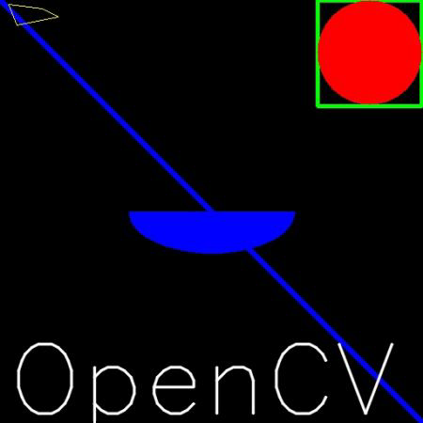
Getting Started with Images
Drawing Function
cv2.rectangle()
cv2.line()
cv2.circle()
cv2.putText()
Save Image
cv2.imwrite()

Slide 11
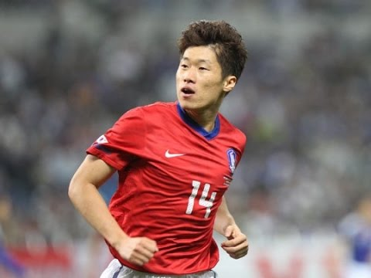
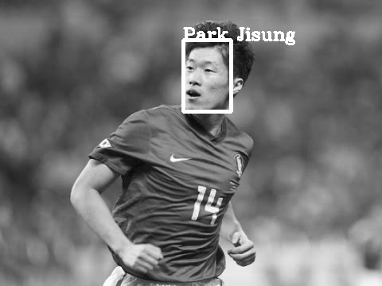
Getting Started with Images
input
output
(x1, y1)
(x2, y2)
drawing
Face Detector
Face Recognizer
input
output
“Park Jisung”

Slide 12
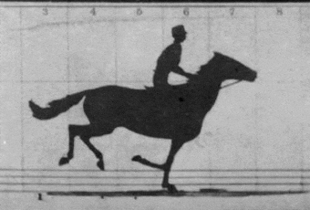
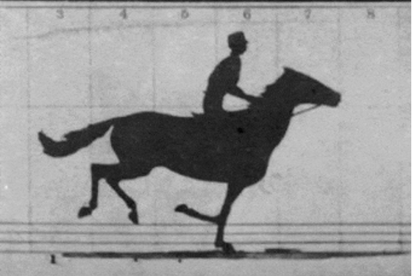
Getting Started with Videos
Frame
Height
Width
(Frame, Height, Width, (Channel))

Slide 13
Getting Started with Videos
Video Capture
cv2.VideoCapture()
cap.get()
cap.set()
Video Write
cv2.VideoWriter()

Slide 14
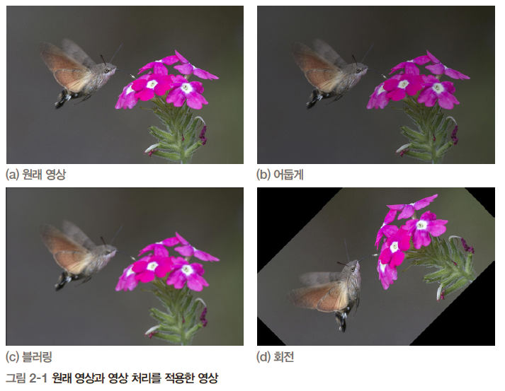
2. Image Processing
주어진 목적을 달성하기 위해 원래 영상을 새로운 영상으로 변환
컴퓨터 비전의 전처리 과정

Slide 15
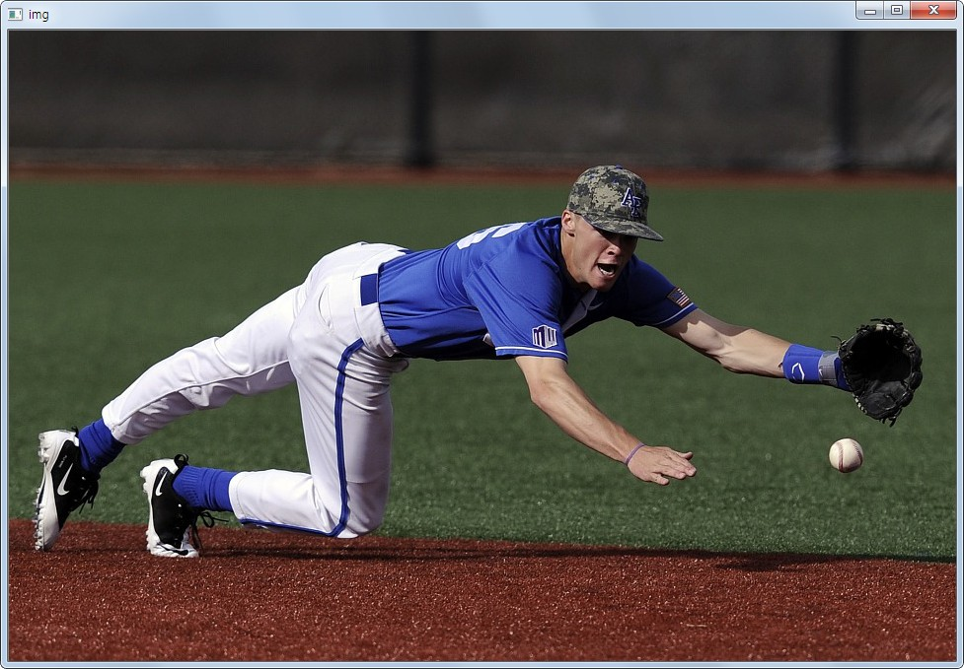
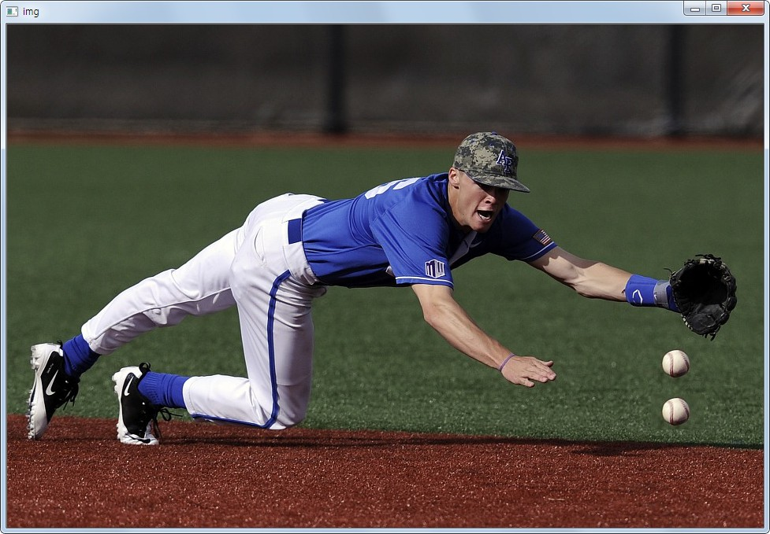
<Access pixel values and modify>

Slide 16
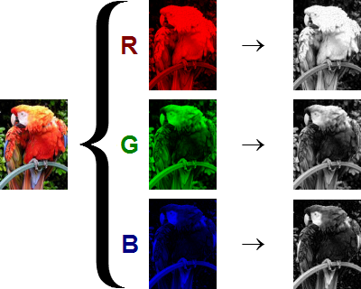
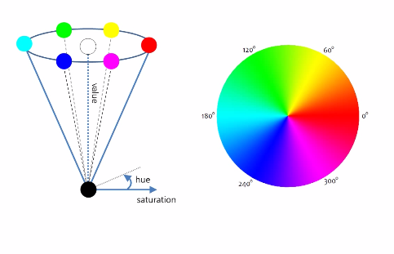
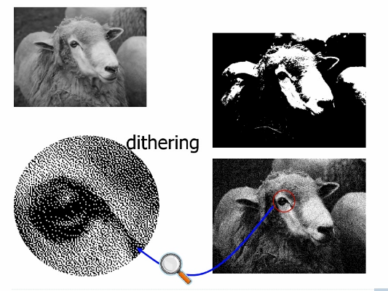
<Changing Colorspaces>
Color Image
Grayscale Image
R : [0 ~ 255]
G : [0 ~ 255]
B : [0 ~ 255]
intensity : [0 ~ 255]
HSV Image
Binary Image
intensity : [0, 1]
Hue : [0 ~360]
Saturation : [0 ~ 255]
Value : [0 ~ 255]

Slide 17
<Changing Colorspaces>
Changing Colorspaces
cv2.cvtColor()

Slide 18
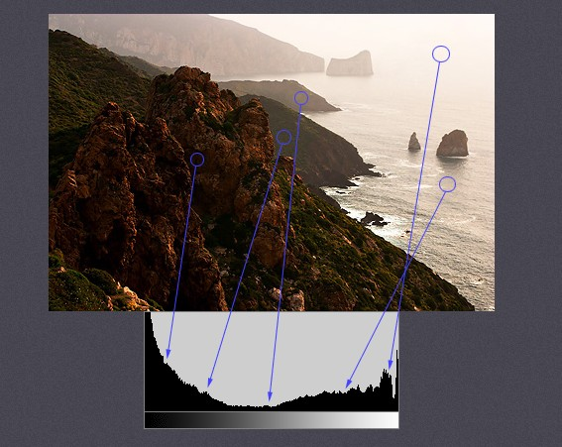
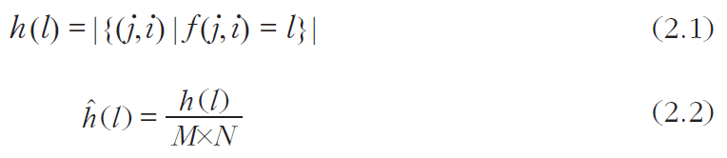
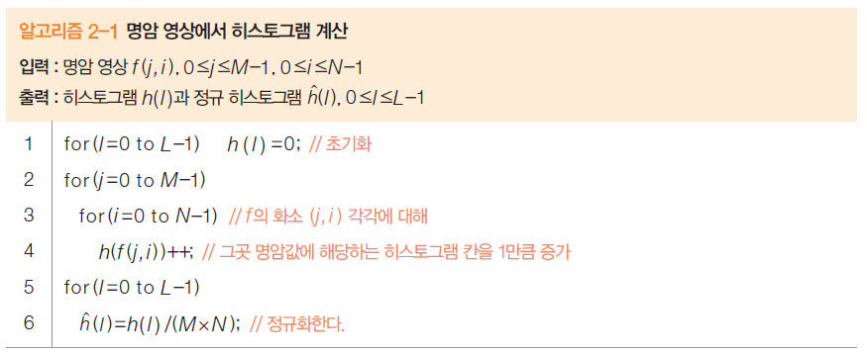
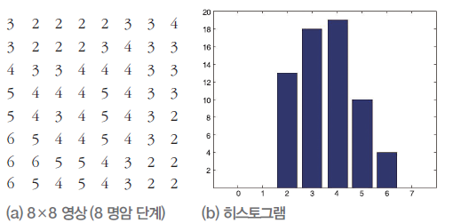
<Histogram>
[0,L-1] 사이의 명암값 각각이 영상에 몇 번 나타나는지 표시
히스토그램 h와 정규화 히스토그램

Slide 19
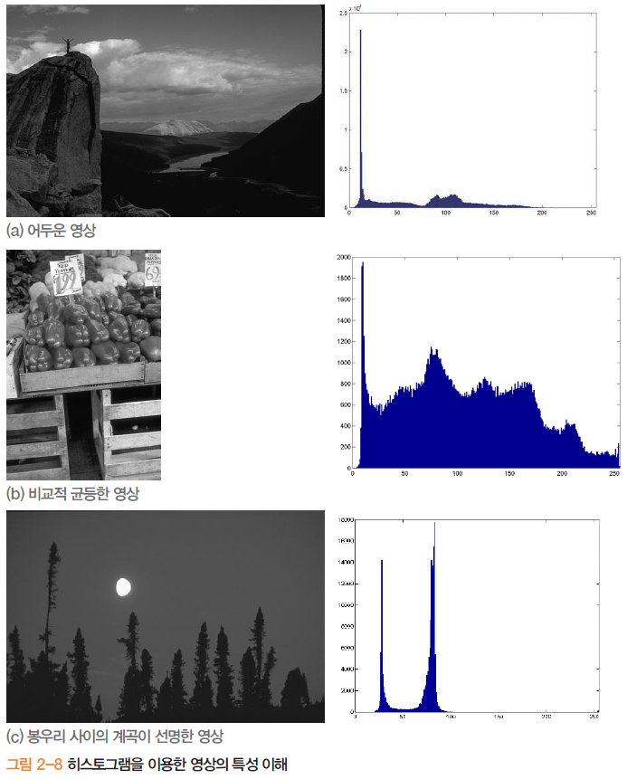
<Histogram>

Slide 20
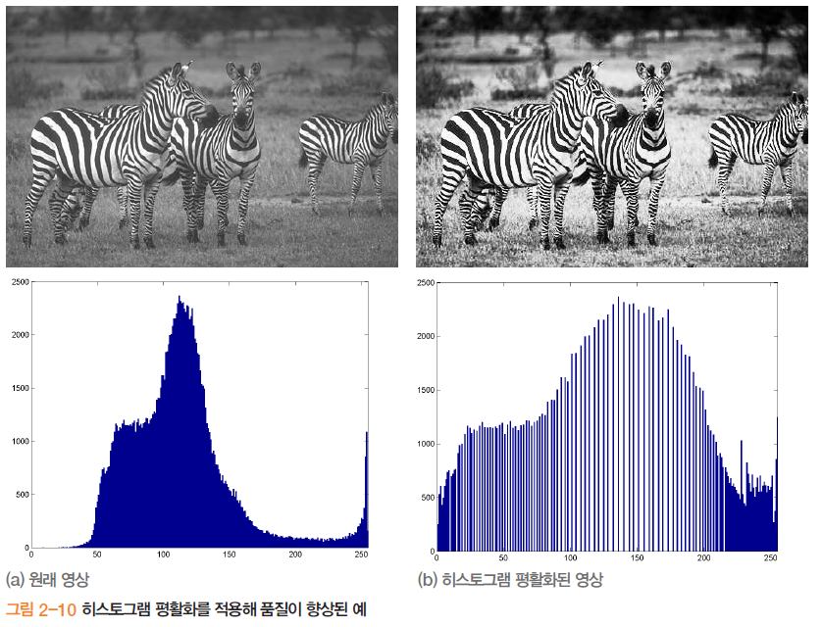
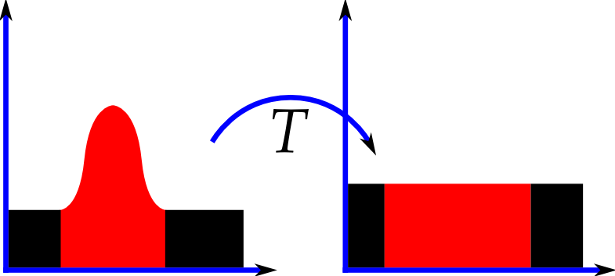
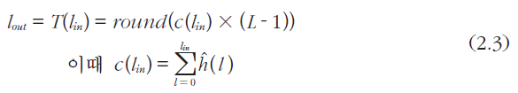
<Histogram>
Histogram Equalization

Slide 21
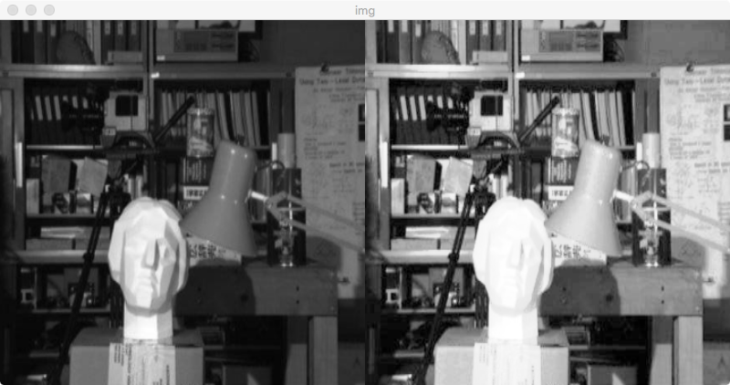
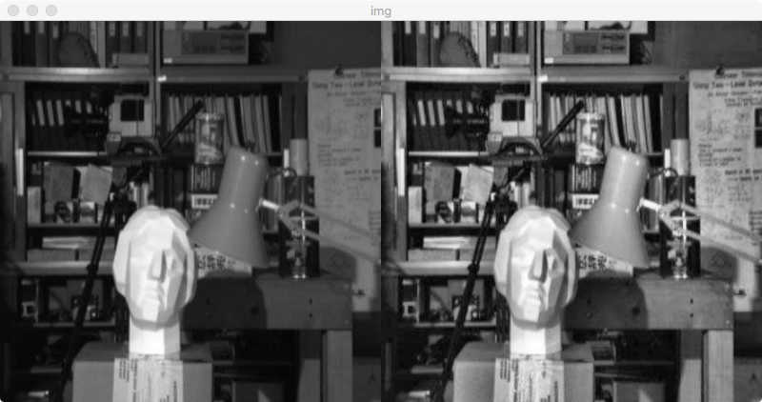
<Histogram>
Histogram Equalization
CLAHE
(Contrast Limit Adaptive
Histogram Equalization)

Slide 22
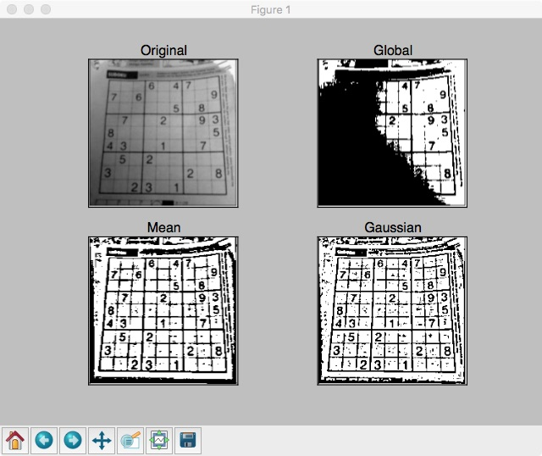
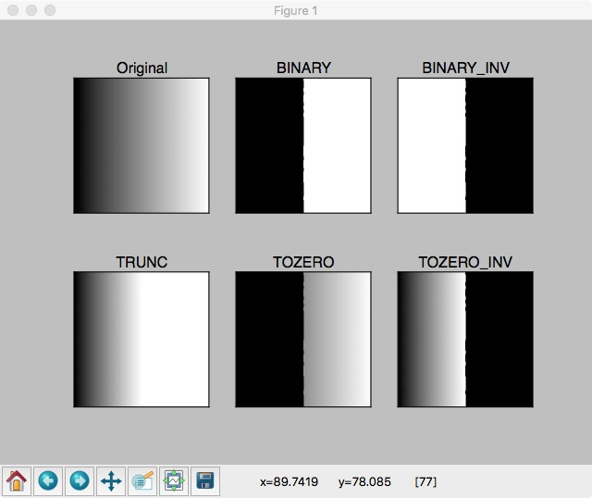
<Image thresholding>

Slide 23
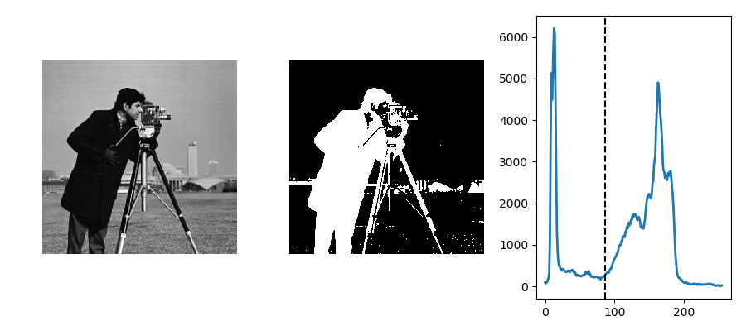
<Image thresholding>
otsu binarization

Slide 24

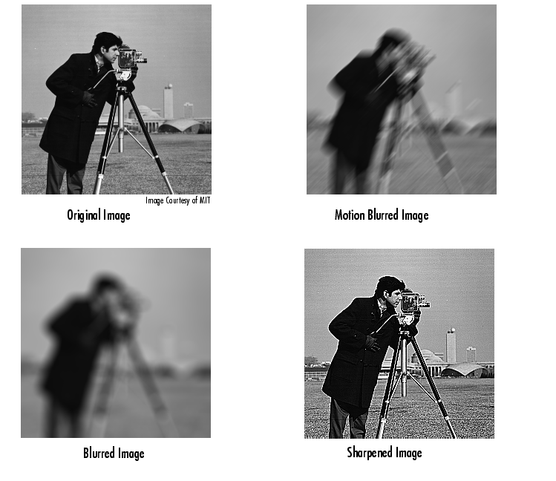
3. Image Filtering
cv2.filter2D()

Slide 25

3. Image Filtering

Slide 26
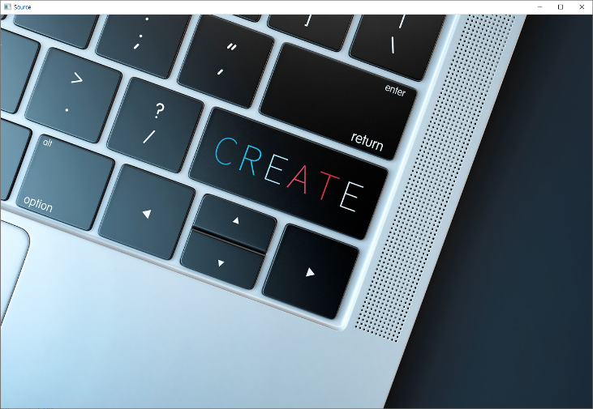

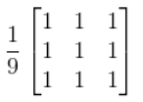
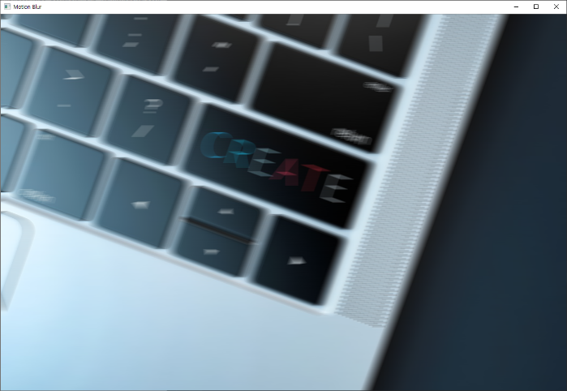
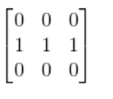
Bluring
Motion blur

Slide 27

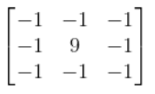
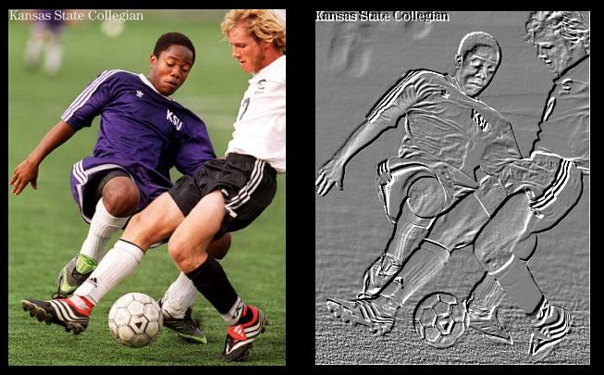
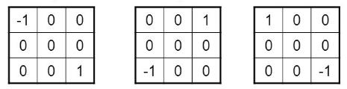
Sharpening
Embossing

Slide 28
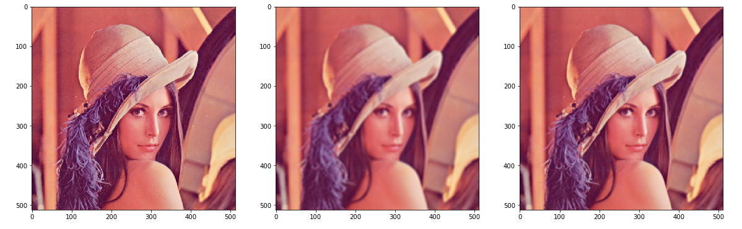
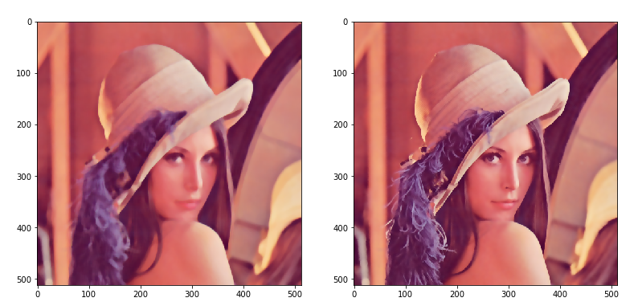
Bluring
cv2.Blur()
cv2.GaussianBlur()
cv2.medianBlur()
cv2.bilateralFilter()

